Slide 1
Architecture-based
software reliability modelling
Hamid Reza Niroomand
A presentation to: Dr. Babamir

Slide 2
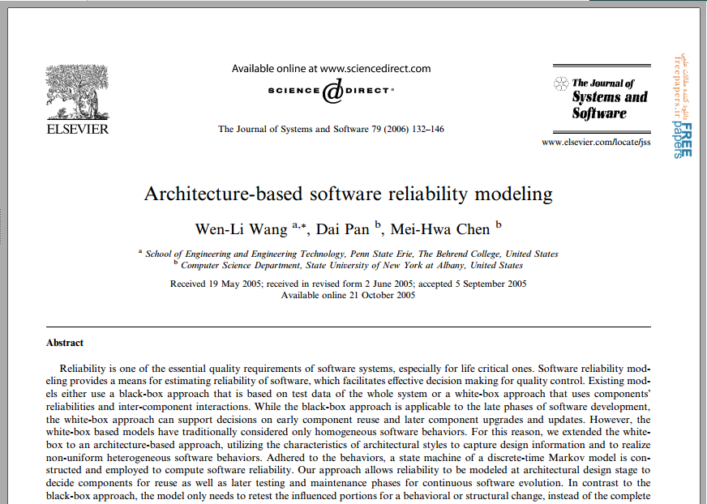


What Design Patterns Are

Slide 3
1. Introduction
Software plays an important role in our daily life, as software failure can lead to a huge economic loss or even endanger lives. Thus, reliability is a critical quality requirement of software and is an important measurement for use in quality assurance.
Improving software reliability effectively requires that software design be refined and design defects be identified as early as possible in the software development life cycle so that cost and efforts can be reduced.

Slide 4
1. Introduction Cont.
Over the past three decades, a number of studies have been conducted for measuring the reliability of software, and many analytical models have been developed.
They measured software reliability using the collected data for the whole system in the observation period.
However, these models using statistical means could be expensive for obtaining sufficient data, and the timing of reliability modeling was subject to the late phase of a software process.
Moreover, these models adopt a black-box approach without looking into internal system structures, so that a small modification would require the complete software to be retested.
In other words, the statistical means and the black-box approach hinder the broad use of these models.

Slide 5
1. Introduction Cont.
To address system structure, a white-box approach that utilized discrete-time Markov chains was developed to model simple homogeneous software structures, such as sequential and branching transitions.
Homogeneous Markov-based modeling approaches are no longer suitable for modeling complex software with heterogeneous infrastructures.
To address heterogeneity, software reliability modeling techniques must take various software architectures into account to yield a better estimation.
In this paper, we show how to incorporate the concepts of software architecture to achieve this goal.

Slide 6
1. Introduction Cont.
The aim of our work is to develop an architecture-based reliability model that takes heterogeneity of software architecture into account to address various types of component interactions.
We use a white-box approach built on top of a traditional Markov-based reliability model.
A state machine is constructed to address software architecture, in which the realization of component interactions and configurations follows the regulations of the identified architectural styles in the system.
Our state machine addresses the characteristics of heterogeneous architecture, which differentiates our model from the existing work.
Notes:
قبلاً در یک مقاله دیگر ثابت کرده بودیم که سیستمی که از استایل‌های معماری مختلف استفاده می‌کند، می‌تواند کارایی یا دردسترس‌پذیری‌های متفاوتی را اريه کند که این تفاوت‌ها در سطح طراحی قابل مشاهده است.
در این مقاله نشان خواهیم داد که قابلیت اعتماد نیز می‌تواند در سطح طراحی، با آنالیز ویژگی‌های استایل‌های معماری به کار رفته در آن اندازه‌گیری شود تا از این طریق، ارتباطات و تعاملات را در حد ارتباطات بین اجزای خود نرم‌افزار محدود کرد و نیازی به بررسی محیط و دیگر عوامل درگیر در نرم‌افزار نباشد.
تعاملات بین مؤلفه‌ها به یک ماشین حالت مدل‌سازی می‌شود و فرکانس تعامل بین دو مؤلفه و قابلیت اعتماد مؤلفه‌ها به صورت احتمال انتقال از یک حالات به حالت دیگر مشخص می‌شود.
در این صورت، محاسبه احتمال یک ترنزیشن فقط بایداجزای درگیر در آن ترنزیشن را مد نظر قرار داد و نه کل سیستم را.
روش ما مانند روش جعبه‌سفید این اجازه را می‌دهد که آزمون بین هر دو مؤلفه‌ی مجاوری انجام شود و نتیجه آزمون آن مؤلفه‌ها (و نه آزمون کل نرم‌افزار) برای به دست آوردن قابلیت اعتماد کل سیستم مورد استفاده قرار خواهد گرفت.
به خاطر این ویژگی، استفاده از یک مؤلفه جدید یا آپگرید یا آپدیت یک مؤلفه فقط نیاز خواهد داشت که مؤلفه‌های تحت تأثیر آزمون مجدد گرفته شوند و نه کل سیستم.

Slide 7
1. Introduction Cont.
The reliability of a system is measured as follows:
The first step is to identify the embedded architectural styles, and for each identified style we develop a state model to address the encapsulated behaviors and constraints.
Second, a global state machine for the whole system is formulated, combining all the individual state models.
Finally, with this global state machine our architecture-based model that extends the traditional Markov-based Models can then be used to compute software reliability.

Slide 8
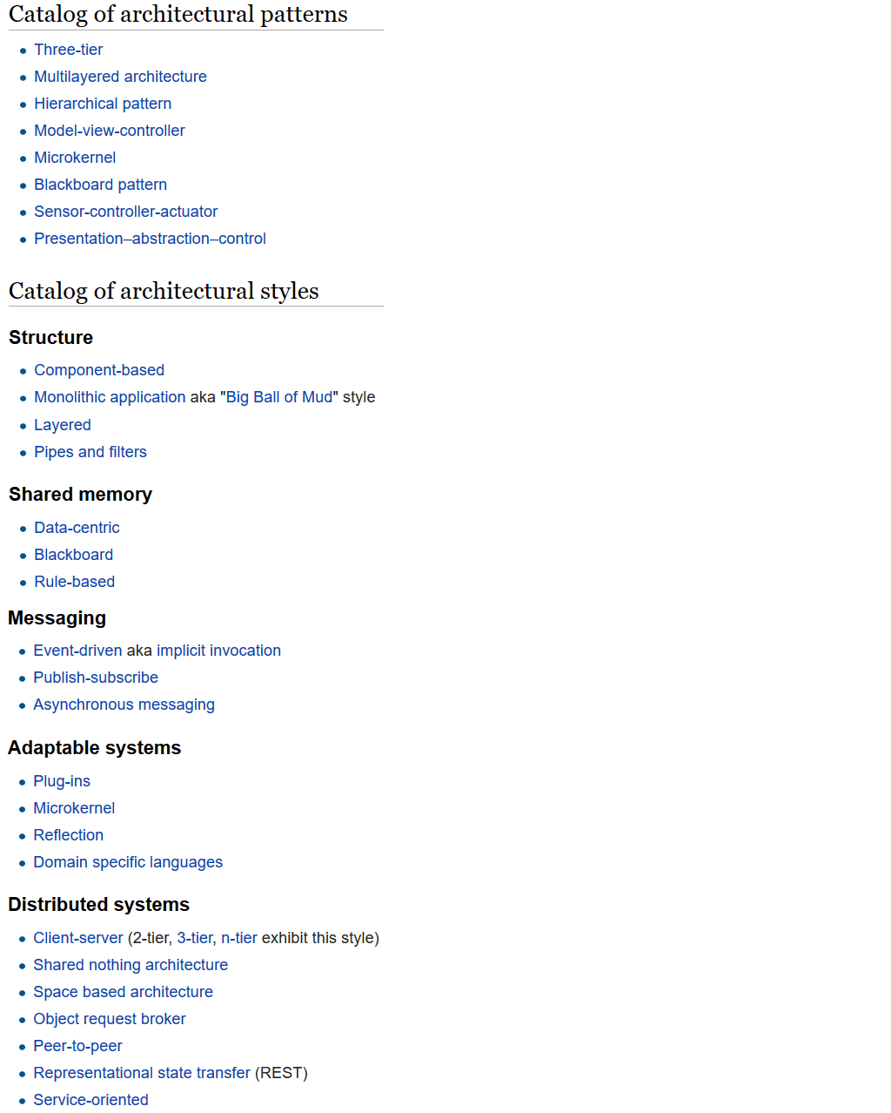
1. Introduction Cont.
Notes:
ابتدا هر سیک را به طور جداگانه مدل‌سازی می‌کنیم و سپس آن‌را به صورت غیرهمجنس ترکیب کرده و ارزیابی می‌کنیم...

Slide 9
1. Introduction Cont.
Architectural Styles used in this paper:
  batch-sequential
  parallel/pipe-filter
  fault tolerance
  call-and-return
Notes:
ابتدا هر سیک را به طور جداگانه مدل‌سازی می‌کنیم و سپس آن‌را به صورت غیرهمجنس ترکیب کرده و ارزیابی می‌کنیم...

Slide 10
2. Architecture-based model foundations
If a software system is a set of software components functioning homogeneously, we can perceive the transition from one component to another as the occurrence of a discrete event.
Rules:
A state is a set of circumstances characterizing a system at a given condition.
A transition is a passage from one state to another, whose transition probability is the probability of undergoing this transition.

Slide 11
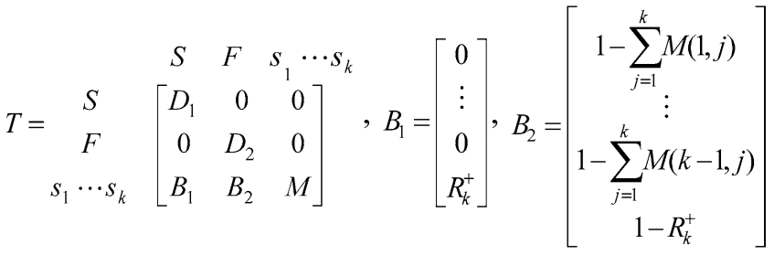
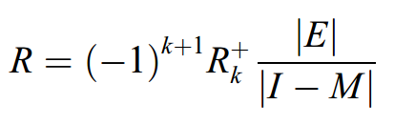
2. Architecture-based model foundations
To model heterogeneity, we construct a different non-negative n x n stochastic matrix T as follows:
Notes:
- S and F are two absorbing states representing the successful output state and failure state
- The inner matrix M is a k x k matrix with only transient states, in which s1 is the entry state and sk is the exit state
- B1 and B2 are two vectors. All the entries of B1 are 0 except the final entry B1(k) with value R+ k , which is the probability that component(s) in the final exit state sk is(are) executed successfully. B2(k) is equal to 1 - B1(k)
- |1-M| is the determinant of matrix (1 - M), while |E| is the determinant of the remaining matrix excluding the last row and the first column of (1 - M)

Slide 12
3. Style-based reliability modeling
In this Section, we demonstrate the reliability modeling for software with homogeneous architectural style.
Three attributes are required in our software reliability modeling:
1- system architecture
2- component reliabilities
3- transition probabilities for every two connecting components
With these three attributes, we transform system architecture into a state machine, in order to construct a Markov model to compute software reliability
Notes:
System architecture is classified into architectural styles to describe different component interactions and intercommunications. The reliability of a component is either measured by traditional approaches or through the inter-component dependency approach proposed by Hamlet et al. (2001). Transition probabilities are observed from an operational profile if available.

Slide 13
3. Style-based reliability modeling
Some notations:
Notation rx represents the reliability of component cx
t(x,y) returns the number of transition occurrences from component cx to cy
Ri is the probability of components successfully executed in state si
Pi,j is the chance from state si to sj regardless of fault propagation
The product of Ri and Pij or simply RiPi,j is perceived as the transition probability from state si to sj, under the realization that components in si function correctly

Slide 14
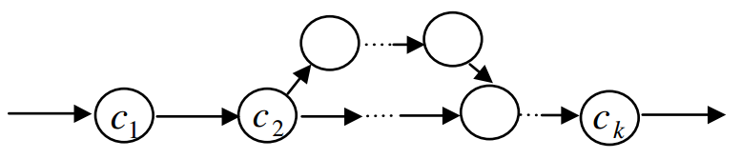
3.1. Batch-sequential style
In a batch-sequential style, components are executed in a sequential manner, i.e., only a single component is executed in any instance of time.
From this type of architecture, the control is transferred to one (and only one) of its successors upon the completion of a component.
The selection of the succeeding component is either probabilistic (if existing more than one successor) or deterministic (if having exactly one successor).

Slide 15

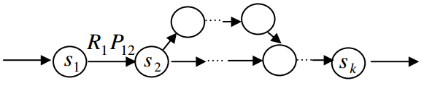
3.1. Batch-sequential style
a k x k matrix M is constructed to compute software reliability. Since the batch sequential style preserves only the common branching and sequential behaviors, the transition probability from state si to state sj, as stored in entry M(i,j)

Slide 16
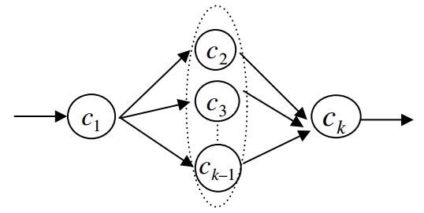
3.2. Parallel/pipe-filter styles
Parallel and pipe-filter styles are commonly used in concurrent execution environments, in which a set of components is usually executed simultaneously to improve performance.
These two styles are quite similar; the main difference is that parallel computation is generally in a cooperative multi-processors environment, whereas the pipe-filter style is mainly in a single processor, multiprocesses environment.

Slide 17
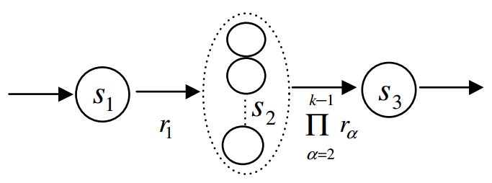
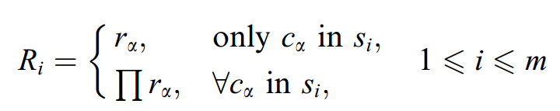
3.2. Parallel/pipe-filter styles
In summary, the state machine of Fig. 2(b) consists of m = 3 states out of k components:
Notes:
m is the total number of states

Slide 18
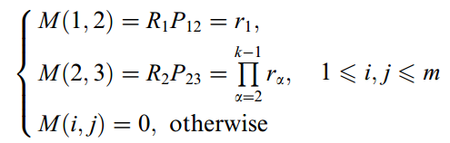
3.2. Parallel/pipe-filter styles
For the modeling of this state machine, a 3 x 3 transition matrix M is constructed as below:

Slide 19
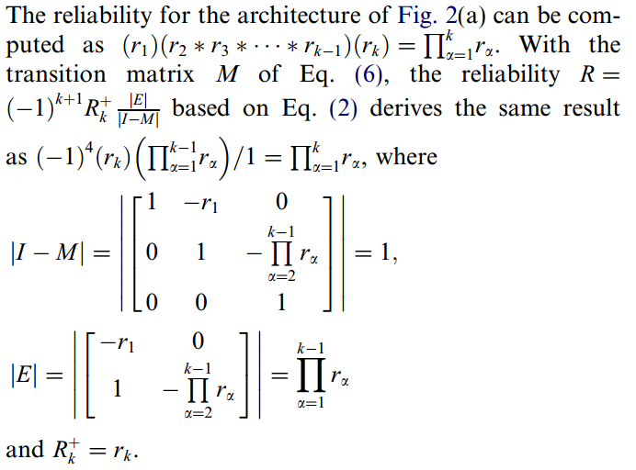
3.2. Parallel/pipe-filter styles

Slide 20
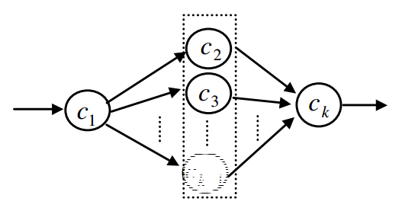
3.3. Fault tolerance
A fault-tolerant architectural style is often adopted to improve availability of software.
Typically, this style consists of a set of fault forbearing components, including primary components and backup components, in which the backup components compensate for the failures of the primary components. When a primary component fails, one of its backup components instantaneously takes over the responsibility and becomes a new primary component. If the new primary component also fails, another backup component will soon take over.

Slide 21
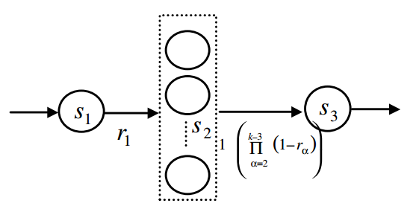
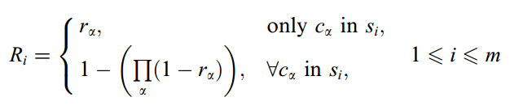
3.3. Fault tolerance

Slide 22
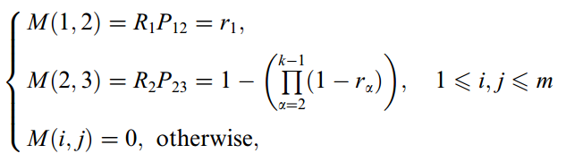
3.3. Fault tolerance
For the modeling of this state machine, a 3 x 3 transition matrix M is constructed as below:

Slide 23
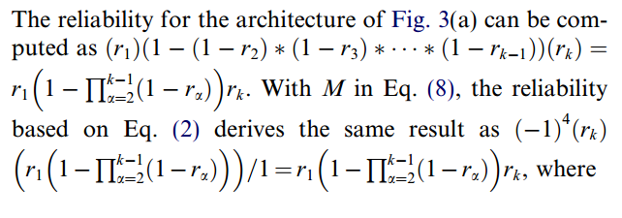
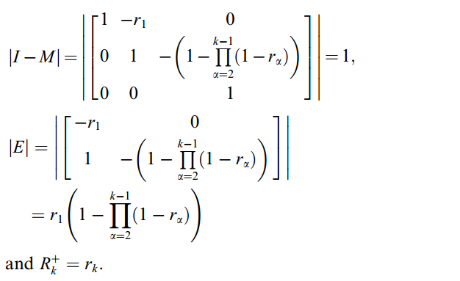
3.3. Fault tolerance

Slide 24
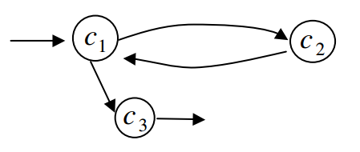
3.4. Call-and-return
Call-and-return style is one of the most prevalent designs for both standalone and distributed systems. The evolutions began from procedure calls, client–server architecture, to object-oriented message passing mechanism.
In this style, a calling component (caller) can invoke a called component (callee) a number of times, and each time the callee returns the requested services back to the caller. For each invocation, the caller performs a context switch by granting a temporary control to its callee and then waits for its response. Once receiving the response, the caller
resumes the execution from where
it left.
Eventually, the caller transfers
its complete control authority to
its subsequent component.

Slide 25
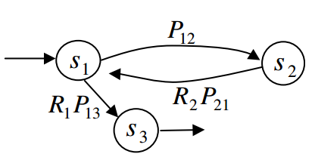
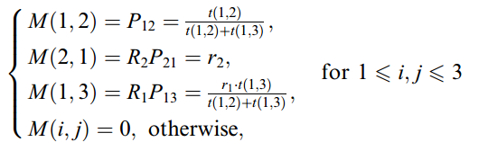
3.4. Call-and-return
For the state machine of the call-and-return architecture a 3 x 3 matrix M is constructed as follows:

Slide 26
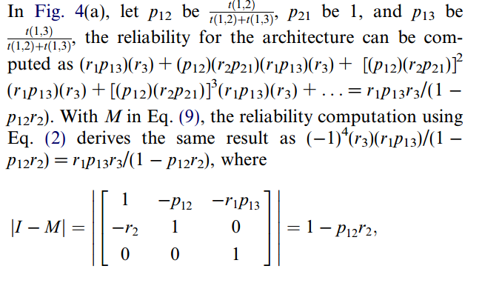
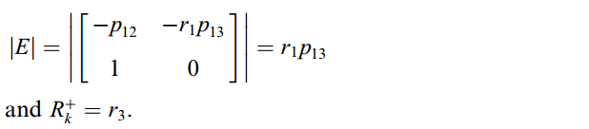
3.4. Call-and-return

Slide 27
4. Architecture-based reliability modeling
To model reliability of software with heterogeneous architectural styles, a systematic approach is presented in the following.
  Step 1: Identify the architectural styles in a system, based on the design specification of a system.
  Step 2: Transform individual architectures of the identified architectural styles into state models.
  Step 3: Integrate these state models into a global state model of the system, based on the overall architecture of a complete system.
  Step 4: Construct the transition matrix M based on the global state model of the system and compute the reliability of the system.
Notes:
Step 1 Notes:
The architectural styles can be characterized from the observations of the interactions among components. In a heterogeneous architecture system, a component may belong to more than one style.
Step 2 Notes:
The transformation can be either a one-to-one mapping or a many-to-one mapping, depending on the characteristics of the components interactions.
Step 3 Notes:
The
process incorporates all of the individual state models to form a global state model. The global state model encompasses the interrelationships of the state models, based on the composed architectural styles.

Slide 28
4. Architecture-based reliability modeling
Some Considerations:
1. Callees are invoked by callers only.
2. Parallel components are independent of fault tolerant components.
3. A set of cooperating parallel or fault tolerant components can also be a caller or a callee.

Slide 29
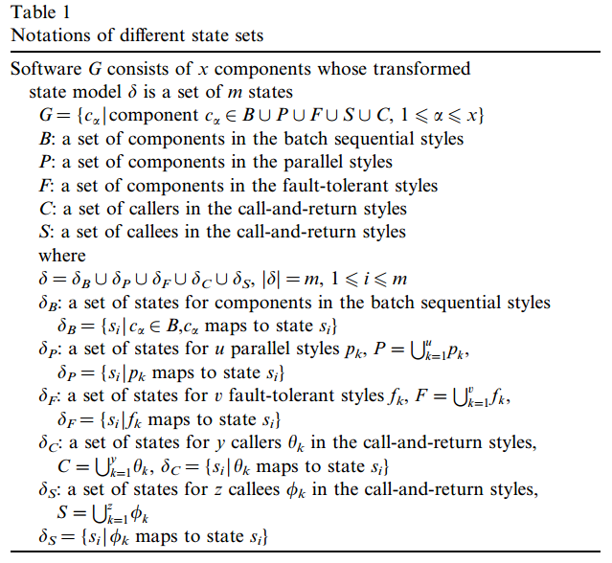
4. Architecture-based reliability modeling
Some Notations:

Slide 30
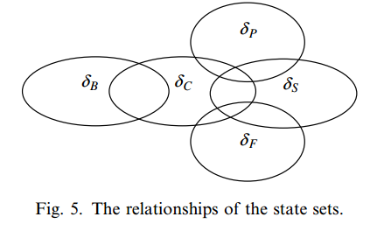
4. Architecture-based reliability modeling
Fig. 5 summarizes all the possible relationships of the state sets:
From Fig. 5, we can classify the state transitions into five types. The first type is for the transition from a caller to a callee. The second type is from a callee returning to a caller. The third one is from a batch-sequential state to a non-callee. The fourth type is from a non-caller/callee parallel state to a non-callee. The last one is from a noncaller/callee fault tolerant state to a non-callee. These five types can be further elaborated into 18 conditions.

Slide 31
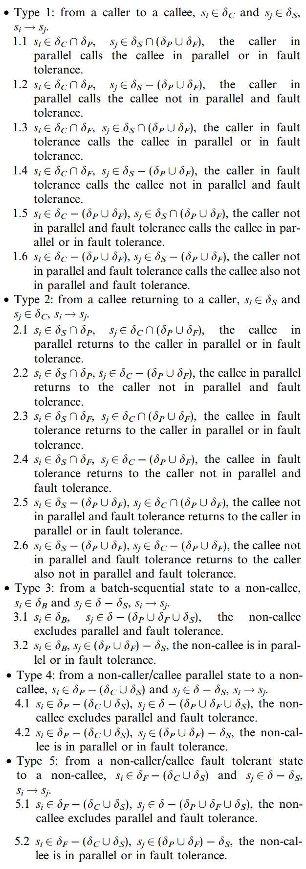
4. Architecture-based reliability modeling

Slide 32
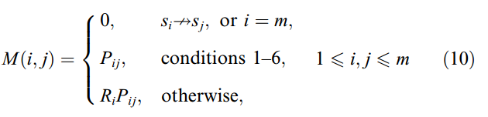
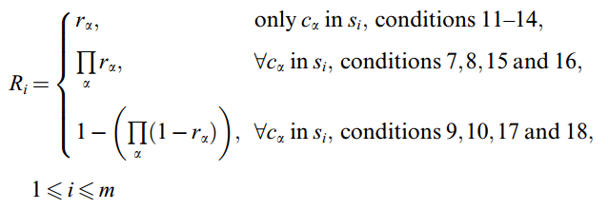
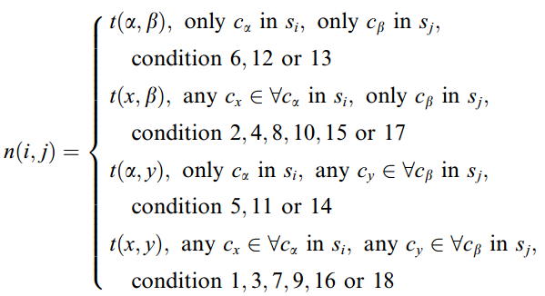

4. Architecture-based reliability modeling
Constructing the matrix:

Slide 33
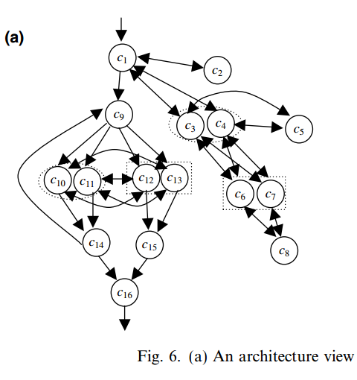
5. An example

Slide 34
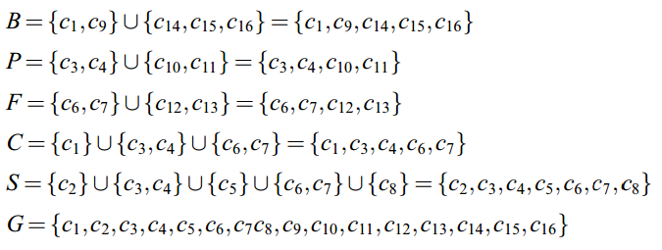
5. An example
Step 1: The first step is to identify the architectural styles in the given system; there are four styles.

Slide 35
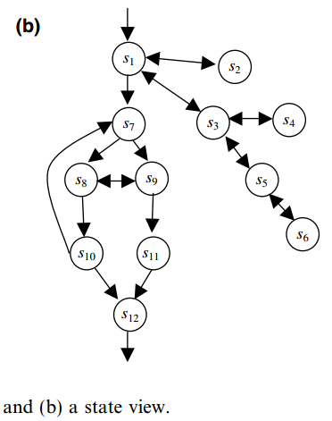
5. An example
Step 2: The second step is to transform
those identified styles into state models.

Slide 36
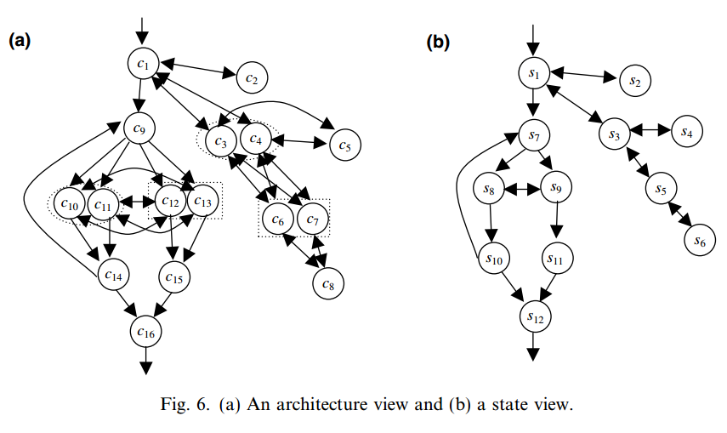
5. An example

Slide 37
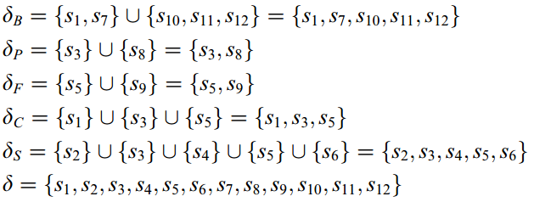
5. An example
Transformation results:

Slide 38
5. An example
Step 3: The integration is to simultaneously address different component interactions among associated state models, in order to model the whole system and derive a global state model.

Slide 39
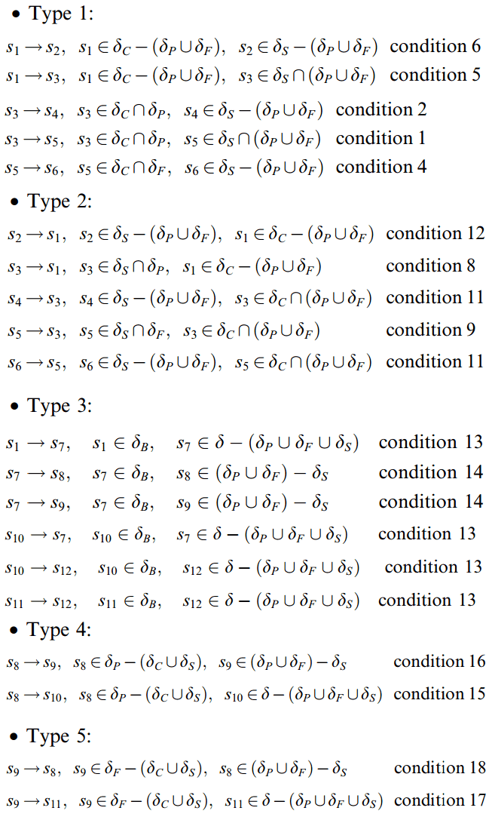
5. An example

Slide 40
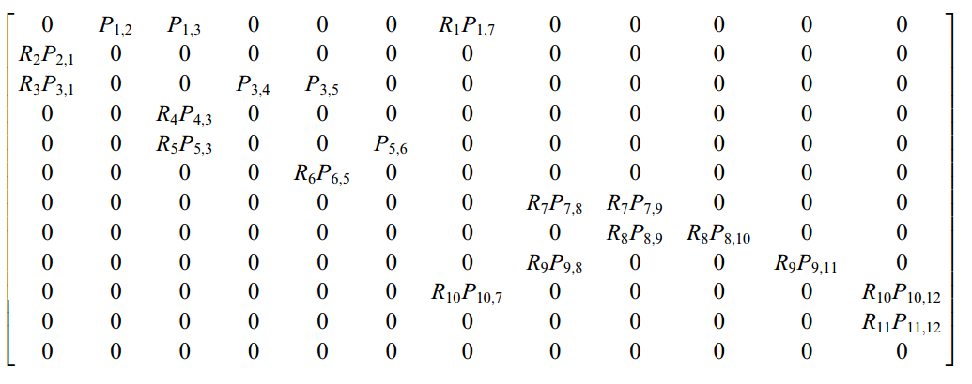
5. An example
Step 4: This final step is to construct a transition matrix M, and compute software reliability using the Markov model.

Slide 41
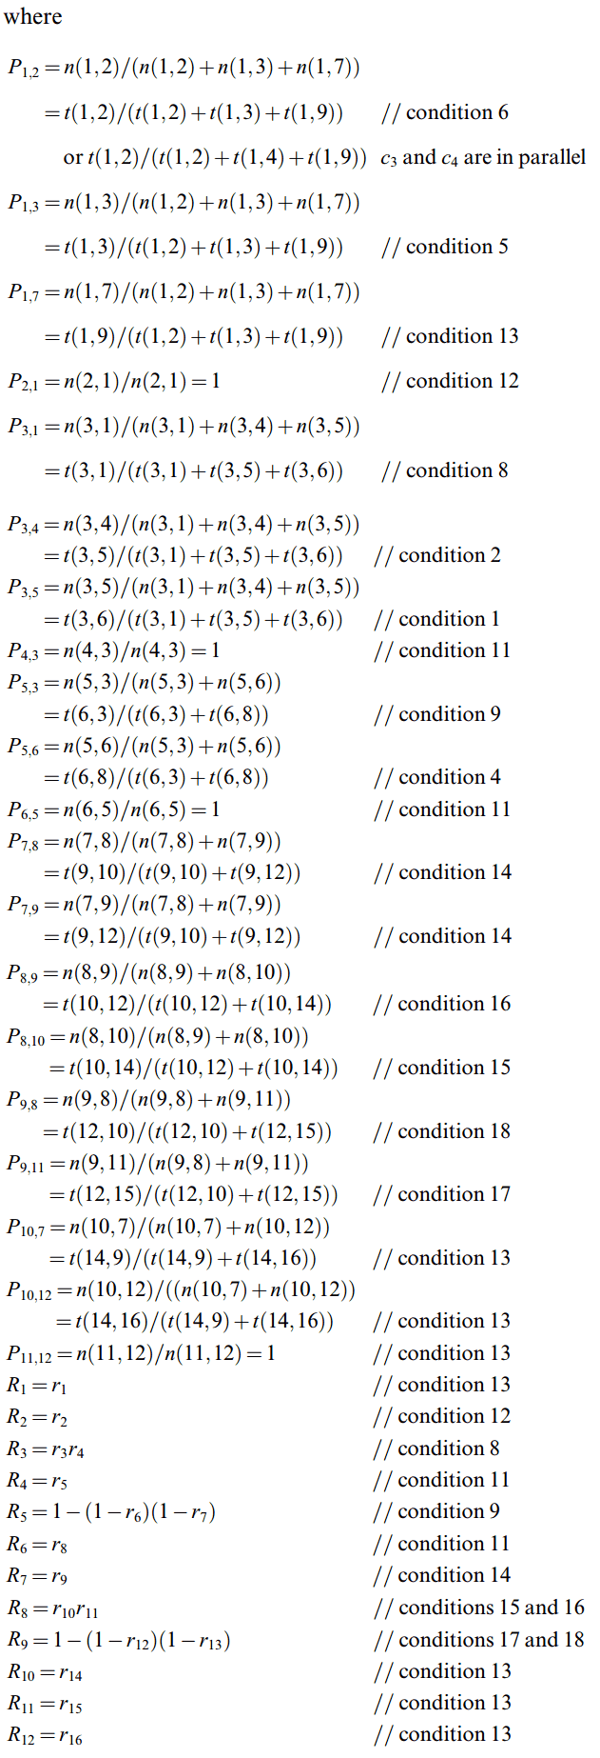
5. An example

Slide 42
5. An example
After the transition matrix M is constructed,
software reliability can be computed, based on Eq. (2) in Section 2:

Slide 43
6. A case study
An empirical study was conducted on an industrial real time component-based system, which has been used by more than 100 companies and 4000 individual users over the past several years. This system provides a set of statistical models to help traders and fund managers analyze the stock market’s historical data and catch future movement.
The system is composed of four sub-units including data unit, business rule unit, utility unit, and presentation unit. These units serve as mathematical libraries and were implemented using C and C++. In this study, we focused on the data unit, which contains 54 classes, 13,846 lines of code, and 921 functions. It has a total of 15 components in three identified architectural styles, including batch-sequential, parallel, and client–server.
A test pool of this system was provided by Quality Assurance (QA) team with a total of 13,596 test cases, and out of those test cases 121 failures were observed.

Slide 44
6. A case study
Finally, we constructed the state machine for the system based on the methodologies described in Sections 3 and 4 and constructed a Markov model to compute reliability by Eq. (2).
The computation yields 0.994001, with 99.4% of executions potentially being failure free.
This reliability result was considered to be acceptable after consultation with the QA team members, who verified that failures were mainly caused by some infrequently executed functions and the chance of running them had been pretty low.

Slide 45
7. Related work
Software Reliability Growth Models (SRGMs) (Farr, 1996; Musa et al., 1987)
  require retesting the whole software if a change or an update occurs to the structure.
Cheung (1980) proposed a user-oriented reliability model to measure the reliability of service that a system provides to a user community.
In Littlewood's (1975, 1979) reliability model, a modular program is treated as transfers of control between modules following a semi Markov process.
…

Slide 46
8. Conclusions
We introduce an architecture-based approach for software reliability modeling, which addresses various software infrastructures and can compute reliability for different component configurations in different phases of a software process.
The state machine is constructed to become a stochastic matrix of a discrete-time Markov model, and software reliability is computed through matrix computations.
This architecture-based approach takes software architecture into account and the white-box feature only needs to retest the affected components or changed structures during software evolution. Therefore, it is useful in guiding the selections of architectural styles and components for reuse in new designs.
An empirical study of this model on a real-time system suggests its great potential for use in modern software infrastructures.
The limitation of this model is the lack of consideration of execution history due to the Markov property, regarding the transitions from a component to others as being probabilistic.
Notes:
In mathematics, a stochastic matrix (also termed probability matrix, transition matrix,[1] substitution matrix, or Markov matrix) is a matrix used to describe the transitions of a Markov chain.

